Slide 1
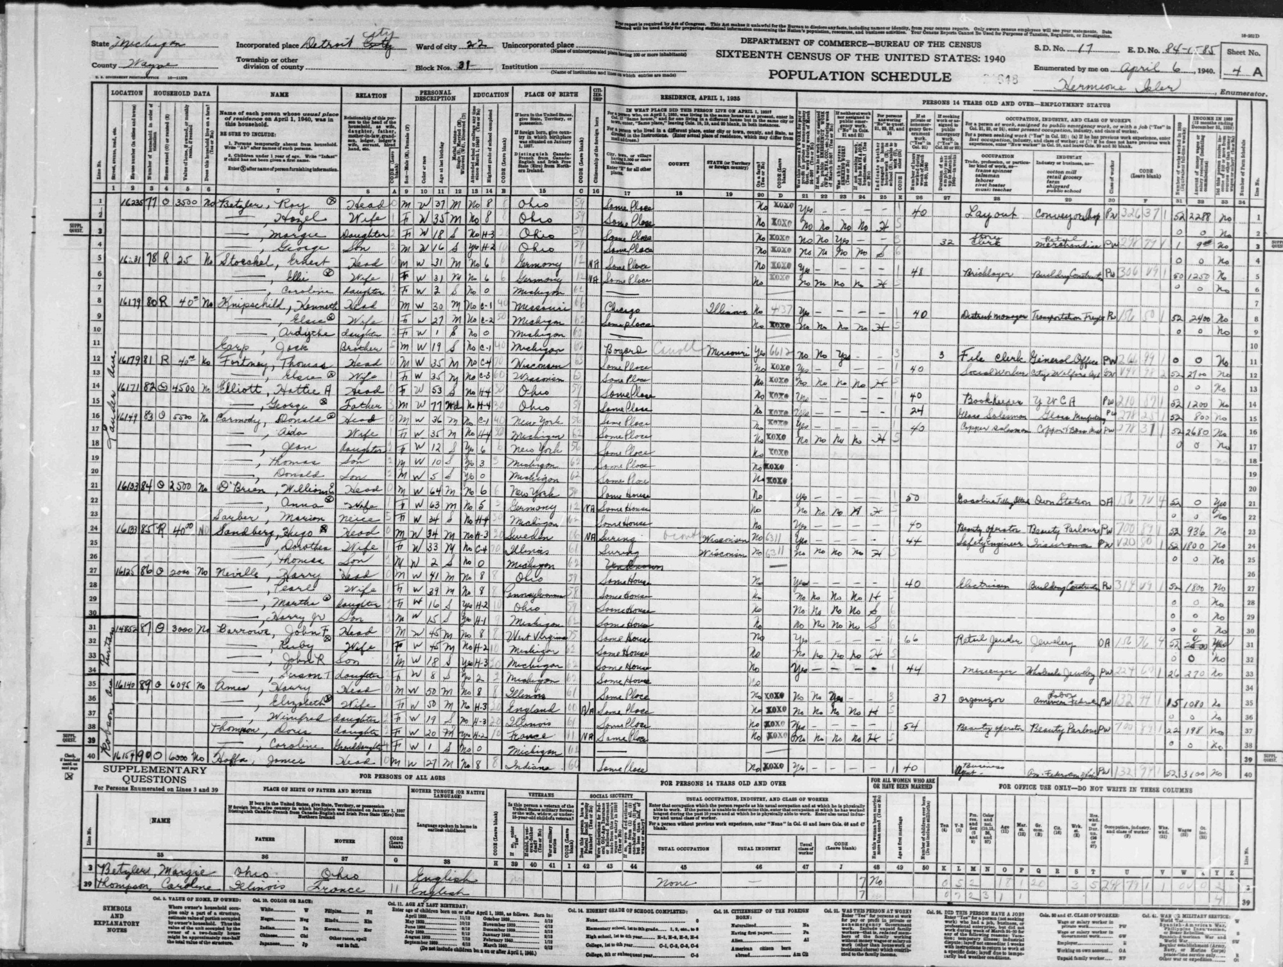
Data types and statistical thinking
Geog4300/6300
Jerry Shannon

Slide 2
Setting the stage:
Write down a research question you’re currently interested in pursuing.

Slide 3
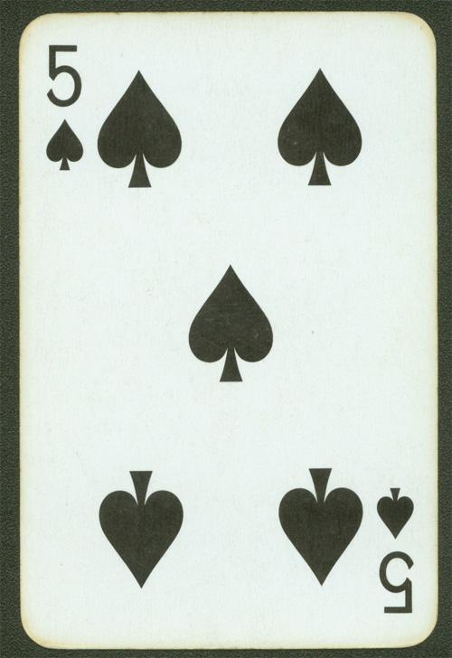
Variable: a category of observation that takes on obtainable values or outcomes for each observation.
Variables: card value, suit, color, etc.

Slide 4
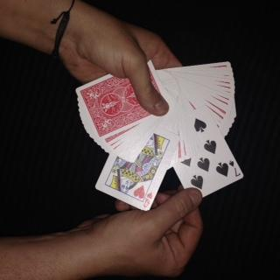
Observation: A single case with recorded values for all variables.
Pick a card. Any card.

Slide 5
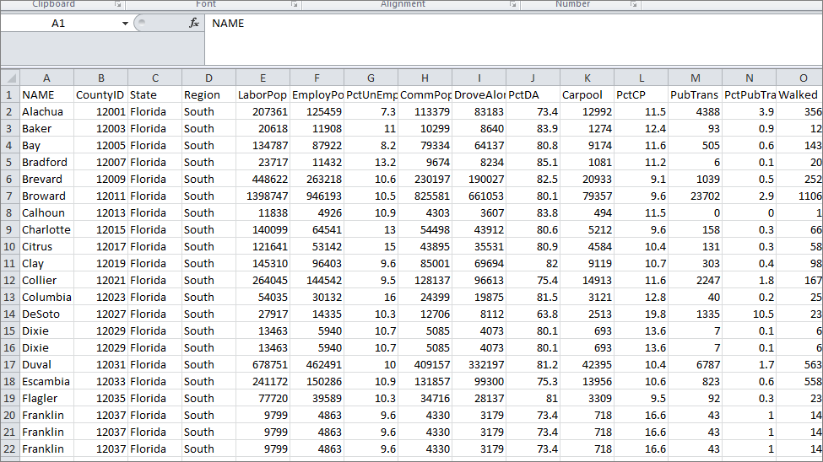
Variables in red
Observations in blue

Slide 6
Dependent and independent variables
dependent: the variable that you want to explain
independent: the variable that you use to explain the dependent one
How does the ___________________
explain the ___________________.

Slide 7
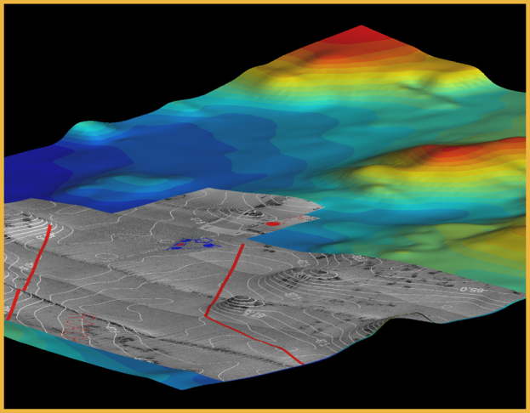
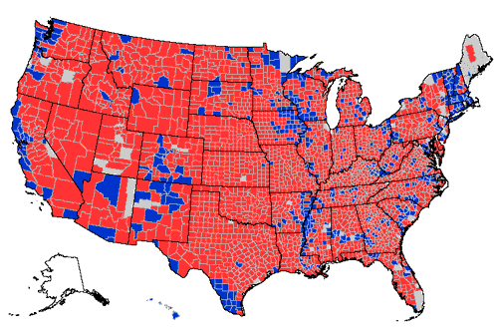
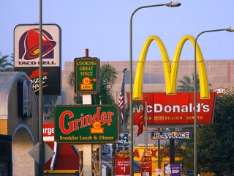
Dependent and independent variables
typical geographic questions:
in what way does elevation influence temperature?
are voters more conservative in the South than the Northeast?
Are fast food restaurants more likely to cluster together than tire repair shops?
Notes:
What are the dependent and independent variables in each of these examples?

Slide 8
Do you have dependent and independent variables in your research question?
If so, what are they?

Slide 9
Levels of measurement
refers to variables, not observations or their values
How is suit as a variable different from number?

Slide 10
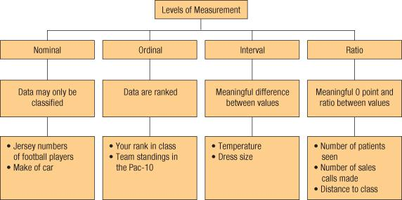
Levels of measurement
Four types:
Categorical (Nominal)
Ordinal
Interval
Ratio

Slide 11
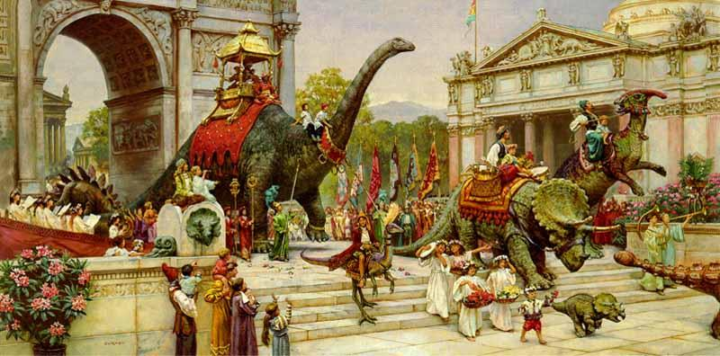
Categorical data
Variables whose values vary in kind or in name; no implied ranking or ordering. Also called “nominal” data.
Some categorical data can be ordered (e.g. geologic periods)
http://emilypothast.files.wordpress.com
Notes:
Come up with some examples of nominal variables that could be used to study Georgia.
Notice that these variables can’t be directly ranked.

Slide 12
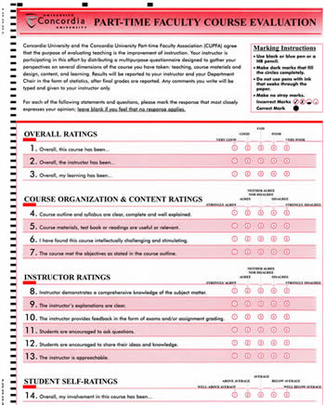
Ordinal data
Numerical and implied rank order, but difference between levels is not defined.
Notes:
Key to remember here is that there’s no mathematical observations that can be done with ranked data.
Example: Teaching evaluations.
Is a teacher with a 4 average twice as good as one with a 2?
Other examples of ordinal data?
College football rankings
Likert scales of all types

Slide 13
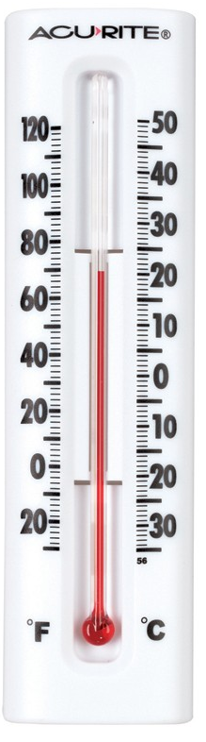
Interval data
Variables whose values can be compared by intervals, but not ratios
**No meaningful zero.**
Can only add and subtract.
Examples: temperature, time (year or clock), IQ tests
Notes:
You can tell exact distances between values; you can add or subtract, but not multiply or divide interval values

Slide 14
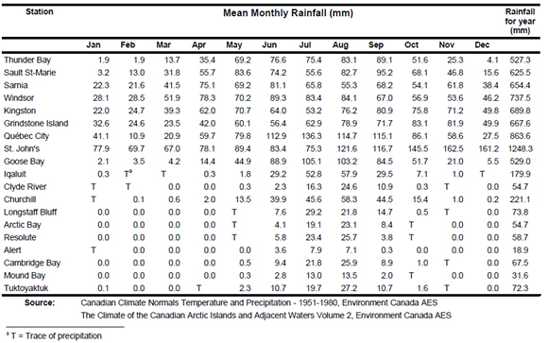
Ratio data
Variables whose values can be compared by taking ratios
Can add, subtract, multiply, divide
Notes:
you can tell exact distances between values; you can add or subtract, but not multiply or divide interval values

Slide 15
Levels of measurement
What kind of data is it?
Letter grades on an essay exam
Year of an important event
Number of students from each country in a large course
Flavors of ice cream
Grams of fat in ice cream
% of consumers who prefer particular flavors of ice cream
Notes:
you can tell exact distances between values; you can add or subtract, but not multiply or divide interval values

Slide 16
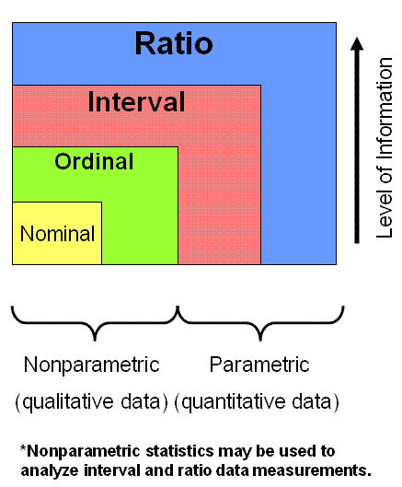
six-sigma-material.com

Slide 17
Classify the data in our course survey
Cartegorical
Ordinal
Interval
Ratio
https://docs.google.com/spreadsheets/d/1K3LflwfRWIoWPCaZzghFZkUX-v9jXhdA3wYzSqEwShU/edit?usp=sharing
Notes:
you can tell exact distances between values; you can add or subtract, but not multiply or divide interval values

Slide 18
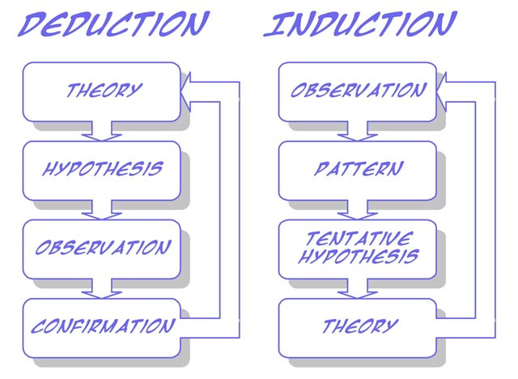
Revisiting models of statistical thinking
http://www.soes.soton.ac.uk
Notes:
Two models of statistical analysis.

Slide 19
Two models of statistical reasoning
Deductive/Hypothesis driven
Theory
Analysis
Hypothesis
Experiment
Notes:
Two models of statistical analysis.
The first is hypothesis driven, where a test is created specifically to test a specific hypothesis: neighborhood racial composition is a predictor of college degree attainment
Clear and focused, based on expanding existing research

Slide 20
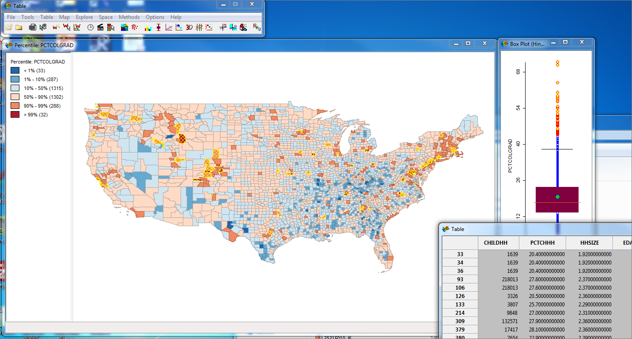
Two models of statistical reasoning
2. Inductive/Exploratory Data Analysis
ESRI
Notes:
Exploratory data analysis is another alternative.
Particularly popular now working with large datasets.
Focus is on working with data and trying to visualize it in multiple ways. Look for patterns that appear in the data that may not be captured by standard statistical models.
Focus is on surprises within the data revealed through multiple passes through it.
May suggest more hypothesis driven experiments or highlight the need for better data.
Example from last time—”elbow” in the connection between HS and college graduation data.

Slide 21

Inductive/Exploratory Data Analysis
John Tukey
“Numerical quantities focus on expected values, graphical summaries on unexpected values.”
Notes:
Exploratory data analysis is another alternative.
Particularly popular now working with large datasets.
Focus is on working with data and trying to visualize it in multiple ways. Look for patterns that appear in the data that may not be captured by standard statistical models.
Focus is on surprises within the data revealed through multiple passes through it.
May suggest more hypothesis driven experiments or highlight the need for better data.
Example from last time—”elbow” in the connection between HS and college graduation data.

Slide 22
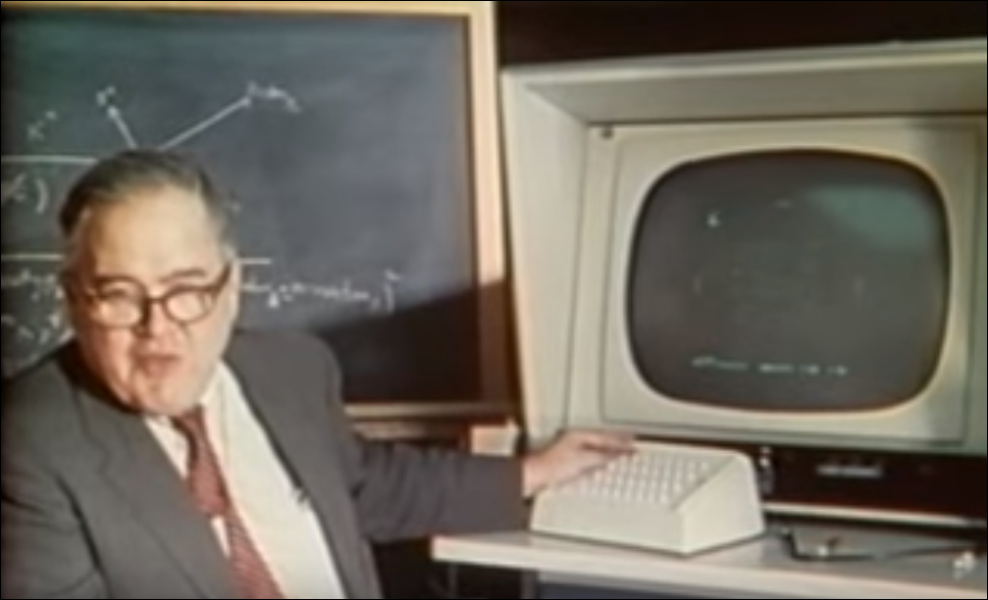
Tukey and visulization
Notes:
Exploratory data analysis is another alternative.
Particularly popular now working with large datasets.
Focus is on working with data and trying to visualize it in multiple ways. Look for patterns that appear in the data that may not be captured by standard statistical models.
Focus is on surprises within the data revealed through multiple passes through it.
May suggest more hypothesis driven experiments or highlight the need for better data.
Example from last time—”elbow” in the connection between HS and college graduation data.

Slide 23
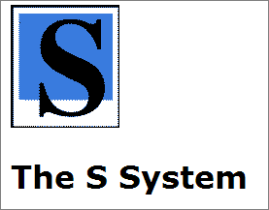

Tukey encouraged the development of the S programming language at Bell Labs.
R is one descendent of this S software package.
Notes:
Exploratory data analysis is another alternative.
Particularly popular now working with large datasets.
Focus is on working with data and trying to visualize it in multiple ways. Look for patterns that appear in the data that may not be captured by standard statistical models.
Focus is on surprises within the data revealed through multiple passes through it.
May suggest more hypothesis driven experiments or highlight the need for better data.
Example from last time—”elbow” in the connection between HS and college graduation data.

Slide 24
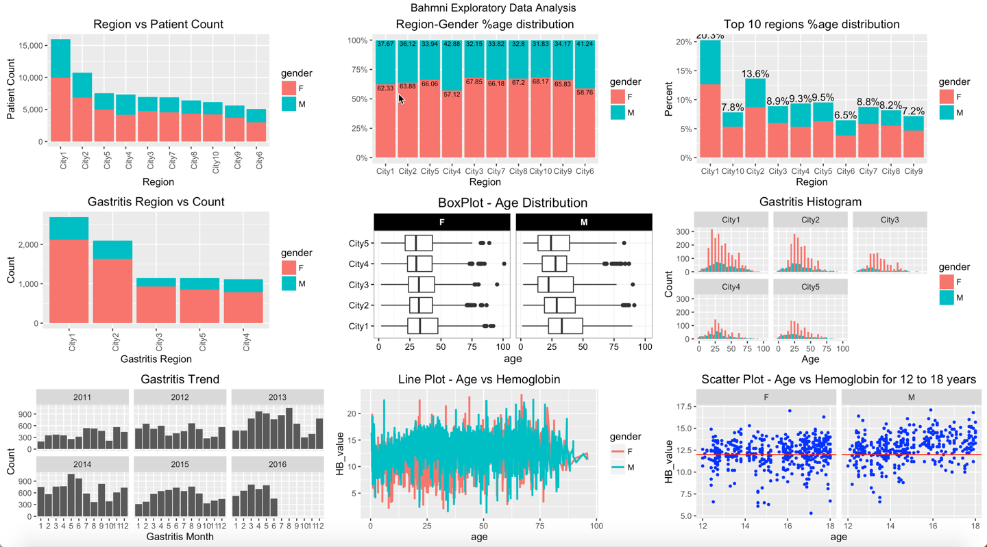
https://medium.com/bahmni-blog/introduction-to-exploratory-data-analysis-of-bahmni-using-r-6c186fd6f010
Notes:
Exploratory data analysis is another alternative.
Particularly popular now working with large datasets.
Focus is on working with data and trying to visualize it in multiple ways. Look for patterns that appear in the data that may not be captured by standard statistical models.
Focus is on surprises within the data revealed through multiple passes through it.
May suggest more hypothesis driven experiments or highlight the need for better data.
Example from last time—”elbow” in the connection between HS and college graduation data.

Slide 25
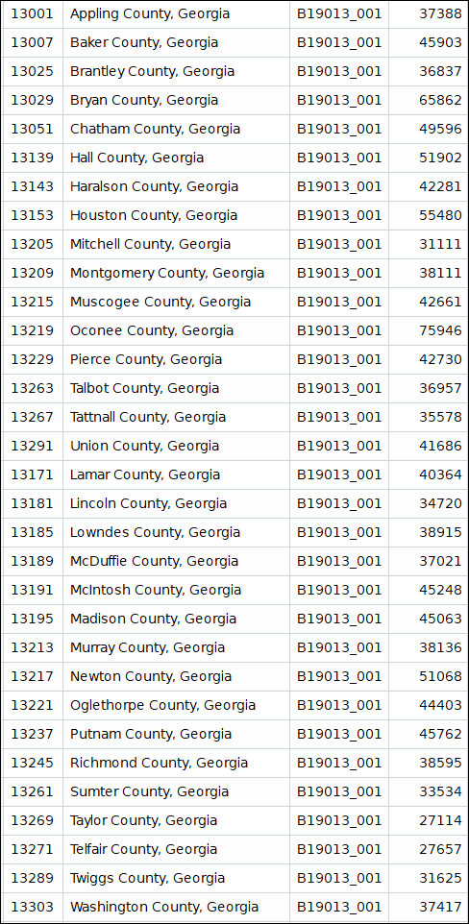
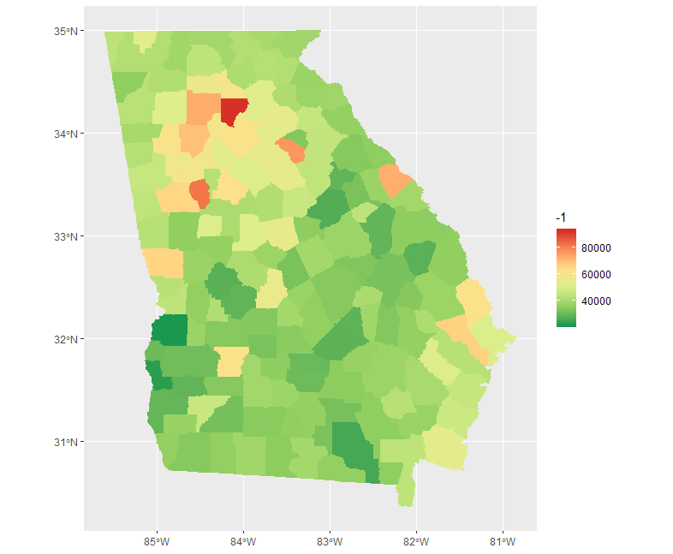
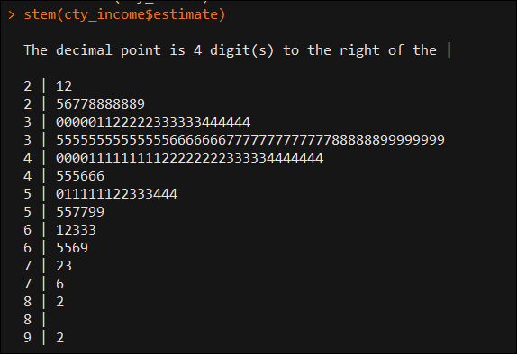
What’s easier to understand?
Notes:
Exploratory data analysis is another alternative.
Particularly popular now working with large datasets.
Focus is on working with data and trying to visualize it in multiple ways. Look for patterns that appear in the data that may not be captured by standard statistical models.
Focus is on surprises within the data revealed through multiple passes through it.
May suggest more hypothesis driven experiments or highlight the need for better data.
Example from last time—”elbow” in the connection between HS and college graduation data.

Slide 26
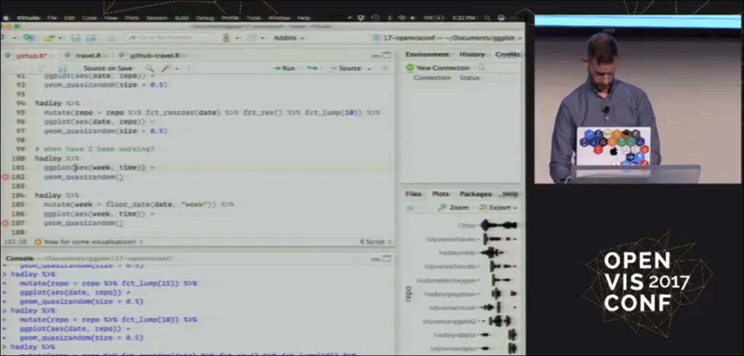
The “tidyverse” provides a set of tools for managing and visualizing complex datasets.
https://youtu.be/ZdPNBF6GWBw
Notes:
Exploratory data analysis is another alternative.
Particularly popular now working with large datasets.
Focus is on working with data and trying to visualize it in multiple ways. Look for patterns that appear in the data that may not be captured by standard statistical models.
Focus is on surprises within the data revealed through multiple passes through it.
May suggest more hypothesis driven experiments or highlight the need for better data.
Example from last time—”elbow” in the connection between HS and college graduation data.

